Slide 1
Saving in Developing Countries: Theory and Review
Angus Deaton (1990)
World Bank Economics Review Presented by Nan Zhi

Slide 2
Motivation
Reasons for studying saving in developing countries separately from saving behavior in developed economies:
At the microeconomic level, developing-country households tend to be large and poor; they have a different demographic structure; most of them are engaged in agriculture and income are uncertain.
At the macroeconomic level, both developed&developing countries concerned with saving and growth. Few developing countries possess that fiscal system permits deliberate manipulation of personal disposable income could help stabilize output and employment.
Most of literature believe that saving is too low, development and growth are impeded by the shortfall. Sometimes the problem is blamed on the lack of policy and misguided policy.
Saving is even more difficult to measure in developing countries at both household level and macroeconomic aggregate.

Slide 3
HOUSEHOLD SAVING BEHAVIOR --------MICROECONOMIC FRAMEWORK
Assumptions (diverges from textbook):
Households tend to be larger and several generation live together so that a household have a stationary demographic structure. Such a household has no need for “hump” or retirement saving.
Income derived from agriculture is with uncertainty. Uncertainty in low income would affect consumption level so that consumption equals to permanent income could not be hold in developing countries.
Borrowing is not permitted. Households may be unwilling to lend for consumption purpose to individuals who have no collateral or to lend across agricultural seasons rather than within them.
Saving provides a buffer between uncertain income and low level of consumption. Saving is intertemporal smoothing saving.

Slide 4
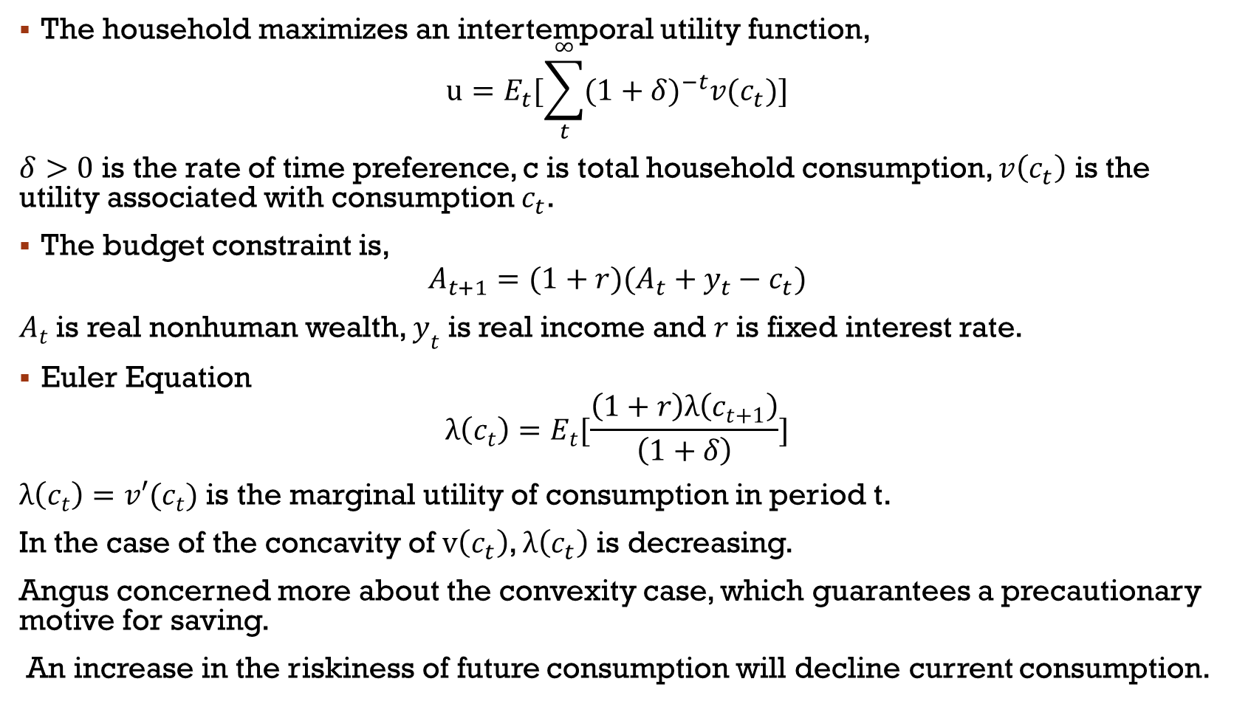
The household maximizes an intertemporal utility function,
$$u=E_{t}[\sum_{t}^{∞}{({1+δ)}^{−t}v(c_{t})}]$$
$δ>0$ is the rate of time preference, c is total household consumption, $v\left(c_{t}\right)$ is the utility associated with consumption $c_{t}$.
The budget constraint is,
$$A_{t+1}=(1+r)(A_{t}+y_{t}−c_{t})$$
$A_{t}$ is real nonhuman wealth, $y_{t}$ is real income and $r$ is fixed interest rate.
Euler Equation
$$λ\left(c_{t}\right)=E_{t}[\frac{\left(1+r\right)λ\left(c_{t+1}\right)}{\left(1+δ\right)}]$$
$λ\left(c_{t}\right)=v′(c_{t})$ is the marginal utility of consumption in period t.
In the case of the concavity of $v\left(c_{t}\right)$, $λ\left(c_{t}\right)$ is decreasing.
Angus concerned more about the convexity case, which guarantees a precautionary motive for saving.
An increase in the riskiness of future consumption will decline current consumption.

Slide 5
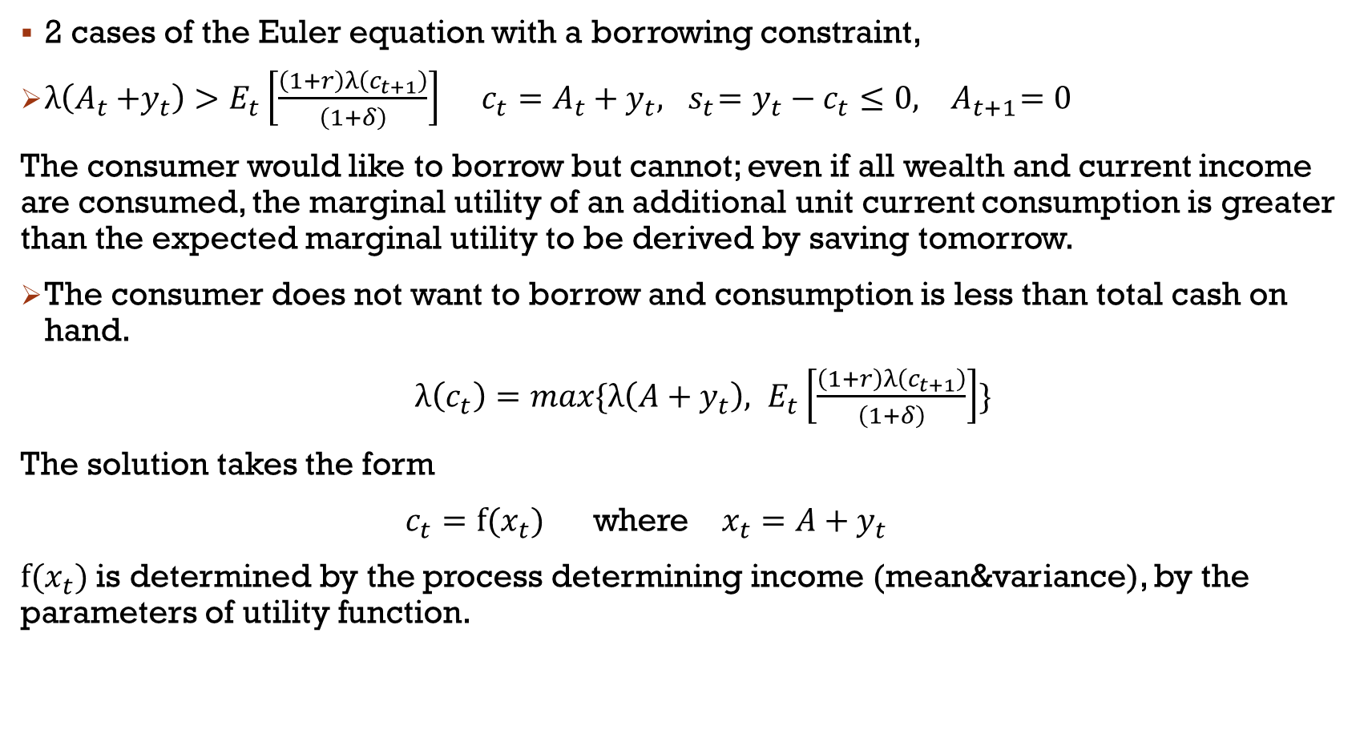
2 cases of the Euler equation with a borrowing constraint,
${λ\left(A_{t}{+y}_{t}\right)>E}_{t}\left[\frac{\left(1+r\right)λ\left(c_{t+1}\right)}{\left(1+δ\right)}\right]$ $c_{t}=A_{t}+y_{t},{ s}_{t}=y_{t}−c_{t}≤0, { A}_{t+1}=0$
The consumer would like to borrow but cannot; even if all wealth and current income are consumed, the marginal utility of an additional unit current consumption is greater than the expected marginal utility to be derived by saving tomorrow.
The consumer does not want to borrow and consumption is less than total cash on hand.
$λ\left(c_{t}\right)=max\{{λ\left({A+y}_{t}\right), E}_{t}\left[\frac{\left(1+r\right)λ\left(c_{t+1}\right)}{\left(1+δ\right)}\right]\}$
The solution takes the form
$c_{t}=f(x_{t})$ where $x_{t}={A+y}_{t}$
$f(x_{t})$ is determined by the process determining income (mean&variance), by the parameters of utility function.

Slide 6
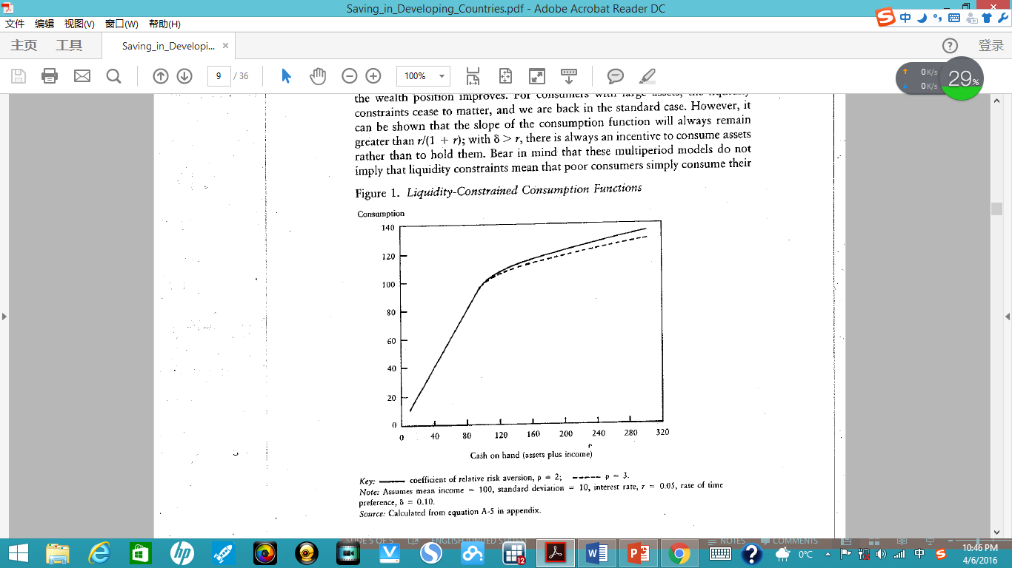
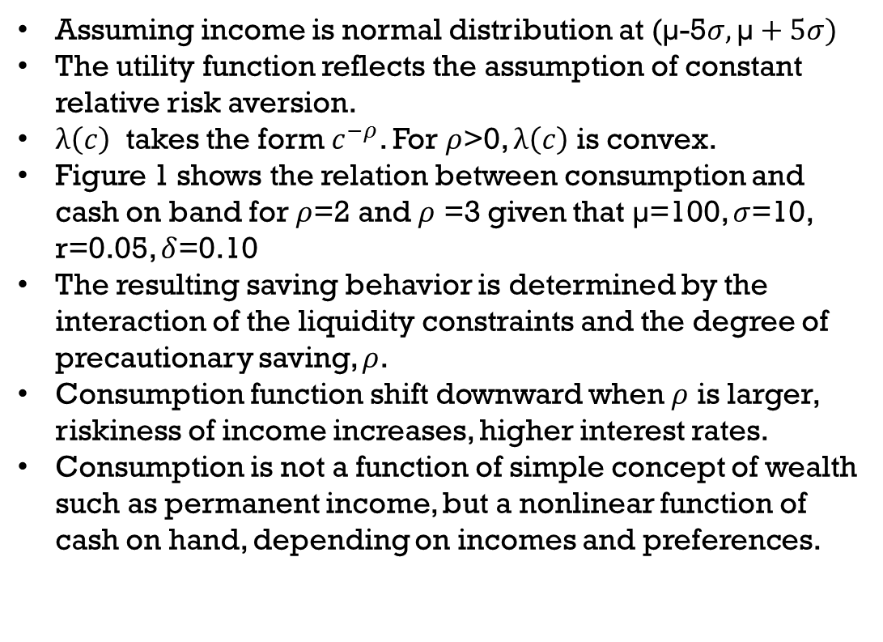
Implications and Relation to the evidence
Assuming income is normal distribution at (µ-5$σ,\text{µ}+5σ)$
The utility function reflects the assumption of constant relative risk aversion.
$λ\left(c\right)$ takes the form $c^{−ρ}$. For $ρ$>0, $λ\left(c\right)$ is convex.
Figure 1 shows the relation between consumption and cash on band for $ρ$=2 and $ρ$ =3 given that $\text{µ}$=100, $σ$=10, r=0.05, $δ$=0.10
The resulting saving behavior is determined by the interaction of the liquidity constraints and the degree of precautionary saving, $ρ$.
Consumption function shift downward when $ρ$ is larger, riskiness of income increases, higher interest rates.
Consumption is not a function of simple concept of wealth such as permanent income, but a nonlinear function of cash on hand, depending on incomes and preferences.

Slide 7
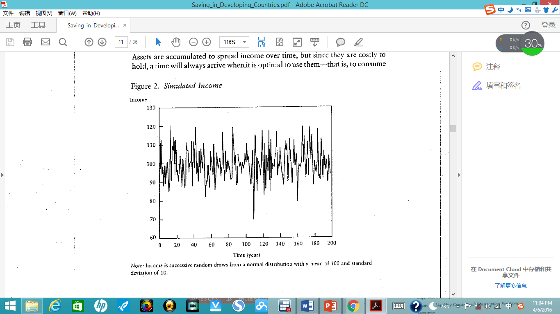
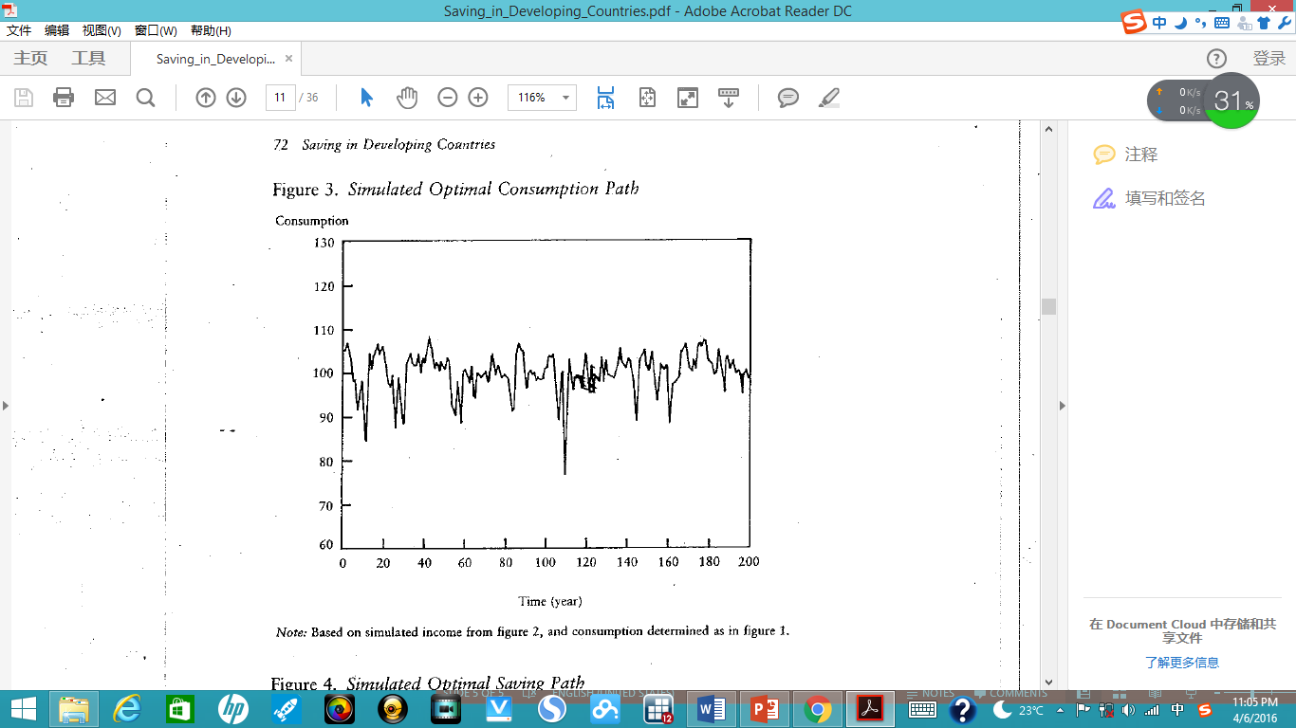
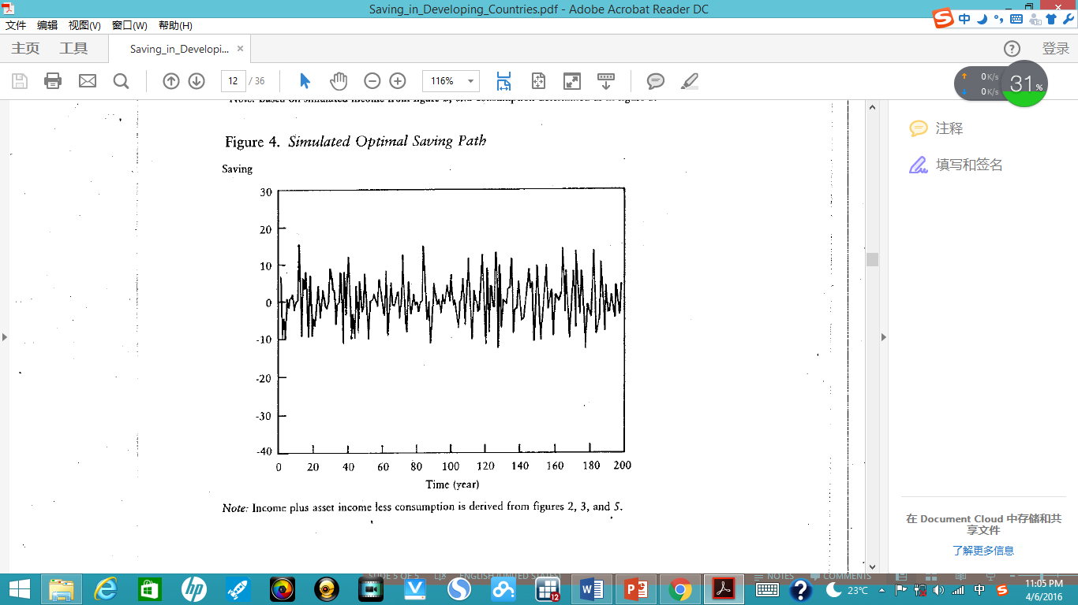
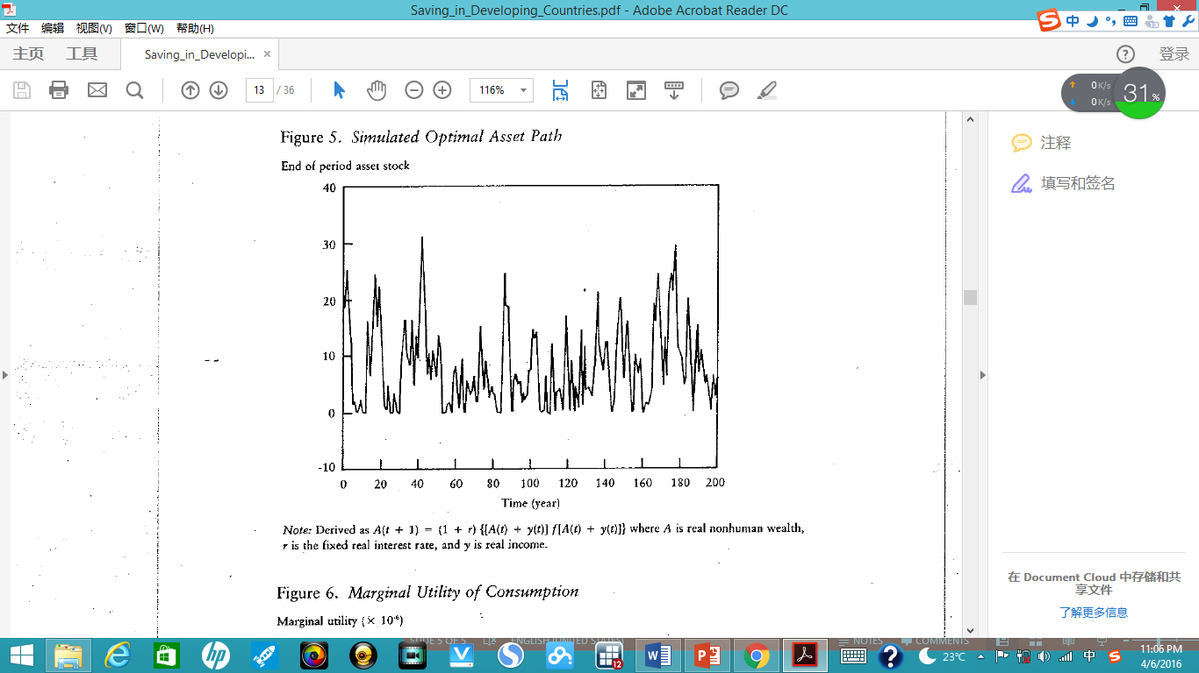

Slide 8
A typical 200-perid simulation for income, consumption, saving, assets. These simulations correspond to the broken line in figure 1, where the coefficient of relative risk aversion is 3.
Assets levels are typically low.
Consumption is much smoother than income and strongly autocorrelated over time.
Saving is as often negative as positive, given the absence of net asset accumulation.
The model shows that households which cannot borrow but accumulate assets as a buffer stock to protect consumption when incomes are low. Over a long enough run of years total household saving would be expected to average to zero.

Slide 9
Macroeconomic Aspect of saving
The life-cycle model: there should be a relation between aggregate saving and the rates of population and income growth.
If saving is hump saving which accumulated during the working years to finance retirement, then population growth provides more savers than dissevers. Positive aggregate saving.
Per capita income growth has similar effect since workers are saving on a larger sale than the retirees are dissaving.
The cross-country empirical evidence from World Bank shows a positive relationship between saving and the total growth of gross national product (GNP).
Data on age-consumption profiles for five countries and areas: Cote d’Ivoire, Hong Kong, Indonesia(rural Java), Korea, and Thailand

Slide 10
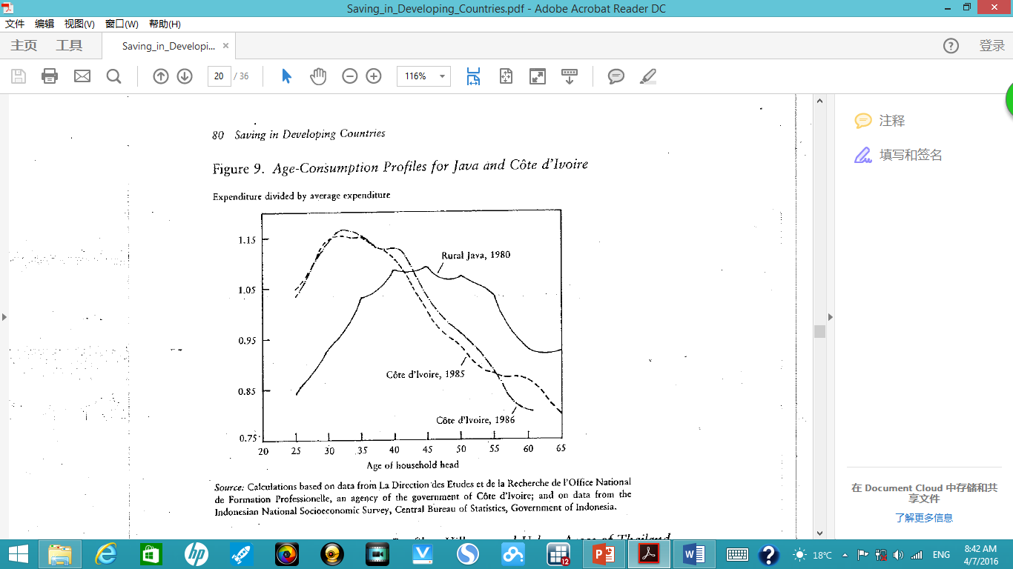
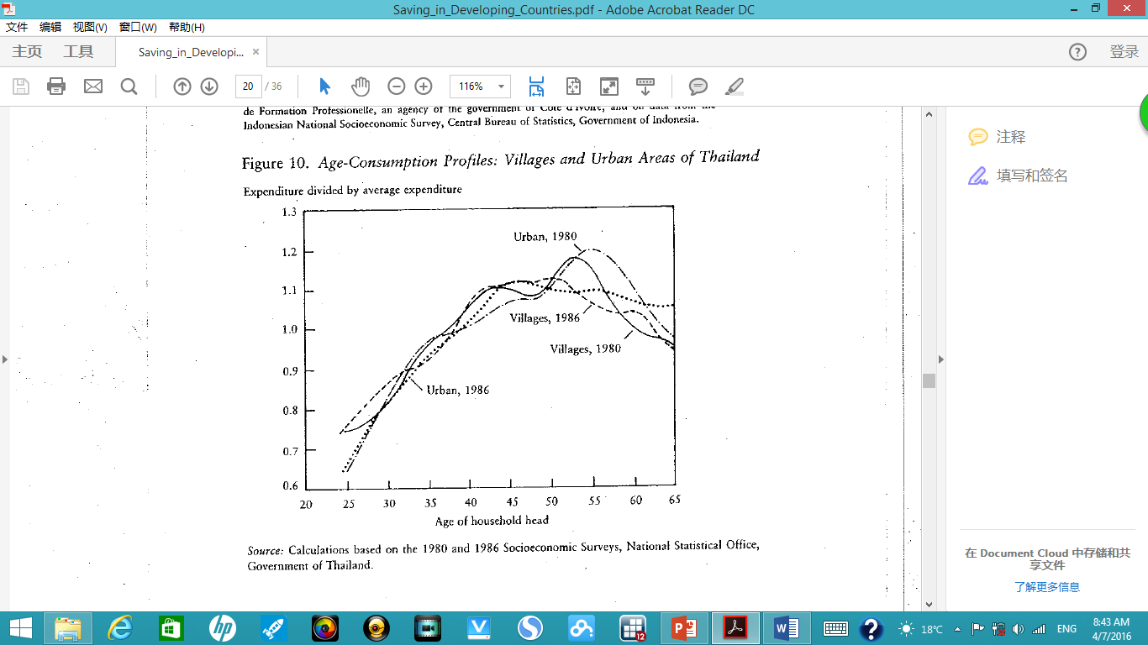
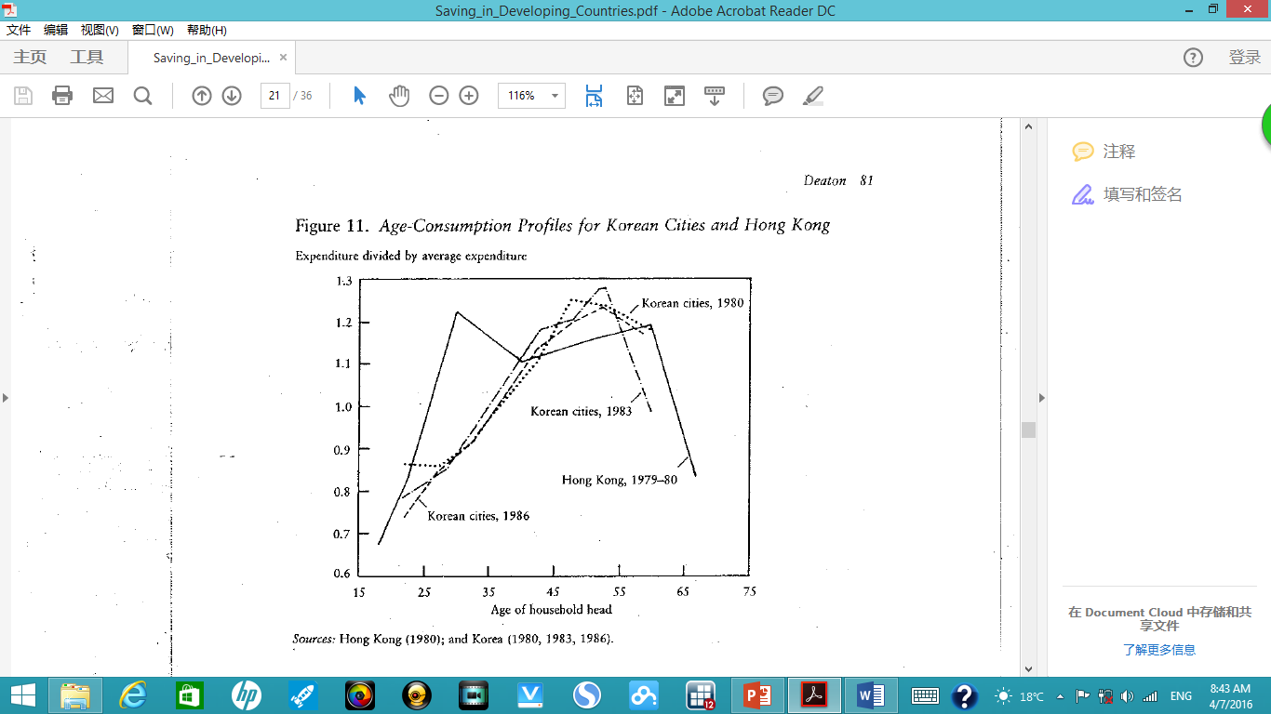
Cote d’Ivoire the consumption profile is heavily tipped toward young
In rural java, the peak is in the mid-forties.
For Thailand and Korea, the profile peaks for households with heads in their fifties.
For Hong Kong, the expenditure seems not vary very much from late twenties to late fifties.

Slide 11
Profiles from the same country are much more similar than profiles across countries.
The relative lifetime economics status of different age groups does not directly determine their current consumption level. The standard explanation of life-cycle rate of growth effect, that younger cohorts are saving and spending on a larger scale does not work

Slide 12
GOVERNMENT POLICY
Government policy could affect household consumption and the level of economic activity by manipulation household disposable income.
Agricultural pricing and tax policy: Agricultural taxation affects the way income fluctuations are shared between government and farmers and so determines who must save to smooth consumption, e.g. coffee was not taxed in Kenya at the time of the coffee boom in 1975-76 so that coffee farmers apparently succeeded in saving a good deal of it. Thai government varies the rice “premium” in such a way as to allow the domestic price of rice to fluctuate with the world price. The government takes a larger share in tax when world price is high so that the income smoothing problem is share between public and private sectors.
Fluctuations in commodity prices: The theory of commodity price determination is demand for inventories interacting with agricultural supply and demand. The underlying supply and demand conditions are assumed to be stationary. So that price process is stationary. As a consequence, price booms and slumps are transitory.

Slide 13
conclusions
Saving is not only about accumulation but about consumption smoothing in the face of volatile incomes, and about providing insurance for poor people whose lives are difficult and uncertain.
At macroeconomics level, the empirical evidence Deaton found could not support the life-cycle model in developing countries.
Data exist would help economists understand how poor households use saving and assets and help government have a positive understanding of response to fluctuations in their revenues. Deaton hoped that the World Bank could take the lead to help data improvements in developing countries.

Slide 14
Comments
As finance market develops in developing counties, if taking off the borrow constraint, how saving behavior could change.
When testing life-cycle model, the author only chose five countries which may have bias and cross-country correlations may exist. Other factors such as family size, number of children etc. did not take into consideration.
Due to the lack of household survey at that time, this paper did not use micro level data. As household survey improving a lot nowadays, micro level data could help analyze saving behavior in developing countries.

